Slide 1
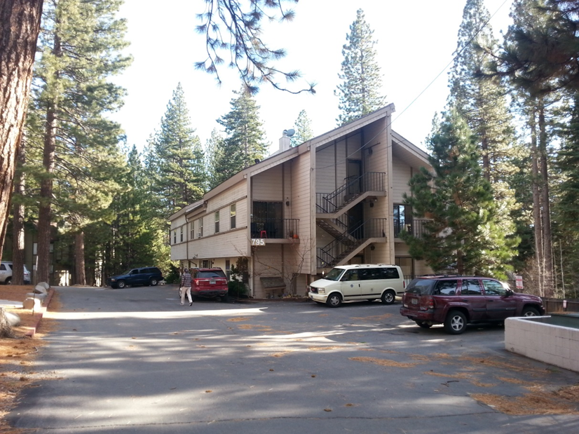
Washoe County Board of Adjustment
February 2, 2017
Administrative Permit Case Number WADMIN16-0001 Carlson and Associates
(Mays Building)

Slide 2
Case Description
Hearing, discussion, and possible action to approve an Administrative Permit to allow the conversion of a portion of the first floor of an existing commercial office building into four residential apartments. The first floor of the building is 3662 square feet in size. Approximately 600 square feet is proposed to remain as a commercial office and approximately 3000 square feet is proposed to be converted into residential space.

Slide 3
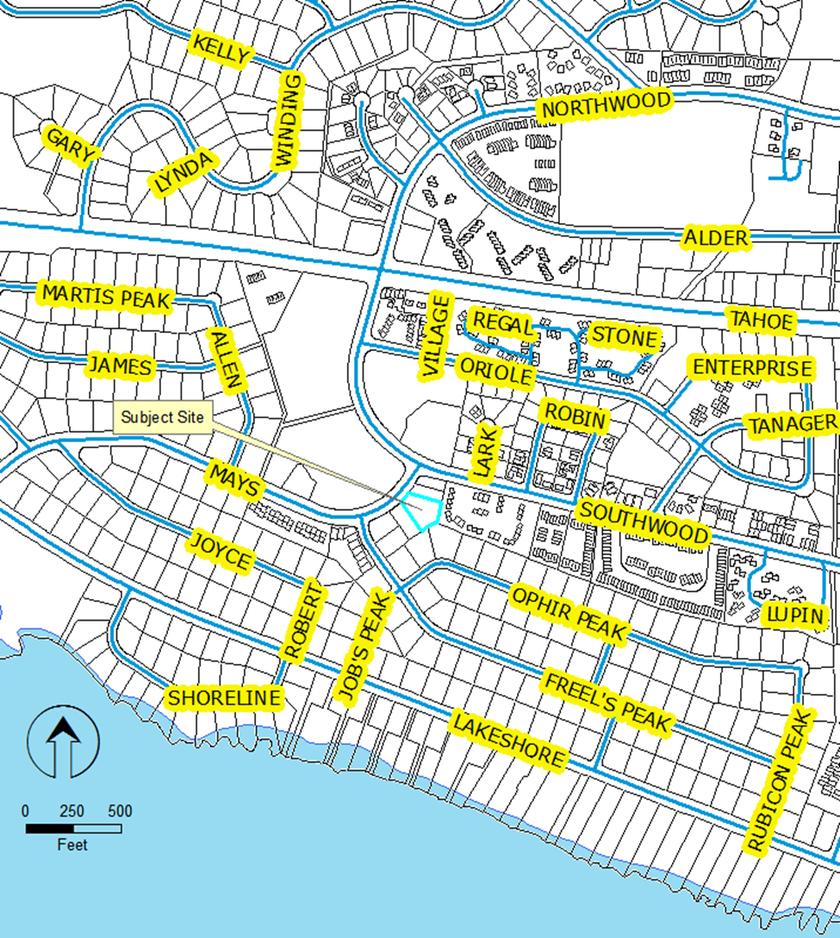
Vicinity Map

Slide 4
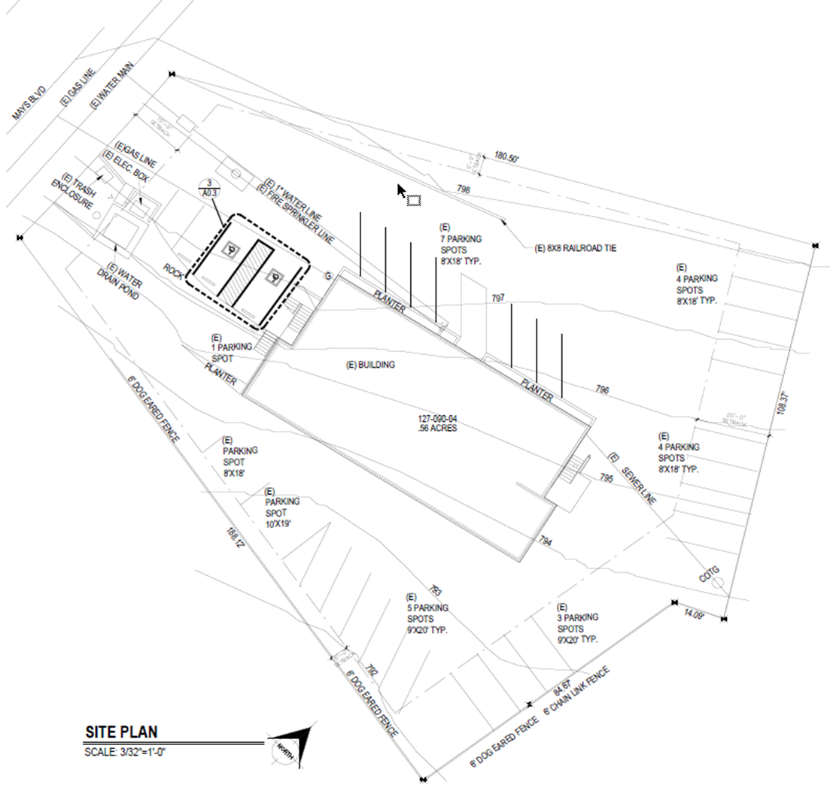
Site Plan

Slide 5
Analysis
Zoned MDU (11 dwellings allowed, 10 proposed)
Exterior of building will not be modified
Surrounded by residential uses
Current Code must be met
Lighting
Landscaping
Buffering
Parking

Slide 6
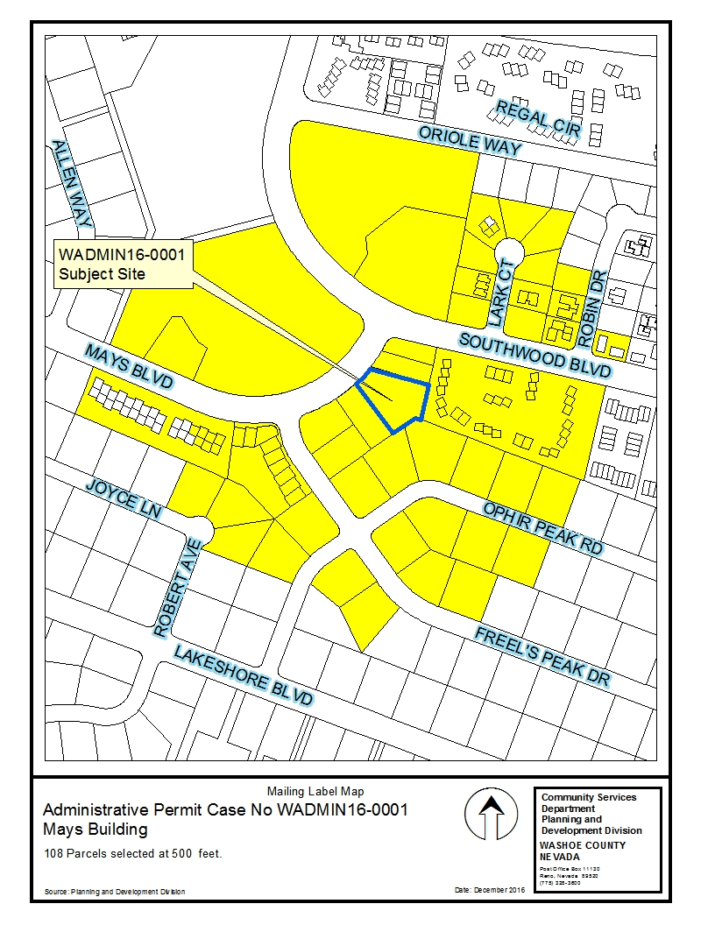
Public
Notice

Slide 7
Conditions of Approval
Standard conditions, generally relating to meeting current Development Code requirements.

Slide 8
Administrative Permit Findings

Slide 9
Administrative Permit Findings

Slide 10
Administrative Permit Findings

Slide 11
Administrative Permit Findings

Slide 12
Administrative Permit Findings

Slide 13
Recommendation
Those agencies which reviewed the application had no comment, or recommended minimal conditions, on the approval of the project. Therefore, after a thorough analysis and review, Administrative Permit Case Number WADMIN16-0001 is being recommended for approval with conditions.

Slide 14
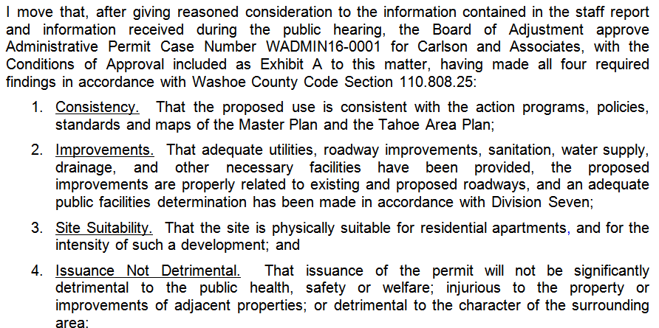
Possible Motion

Slide 15
Questions?

